Slide 1

Database Managment System
AHMED AMRO ABDELMONEIM KANDIL
4211133
A3

Slide 2
Examples

Slide 3
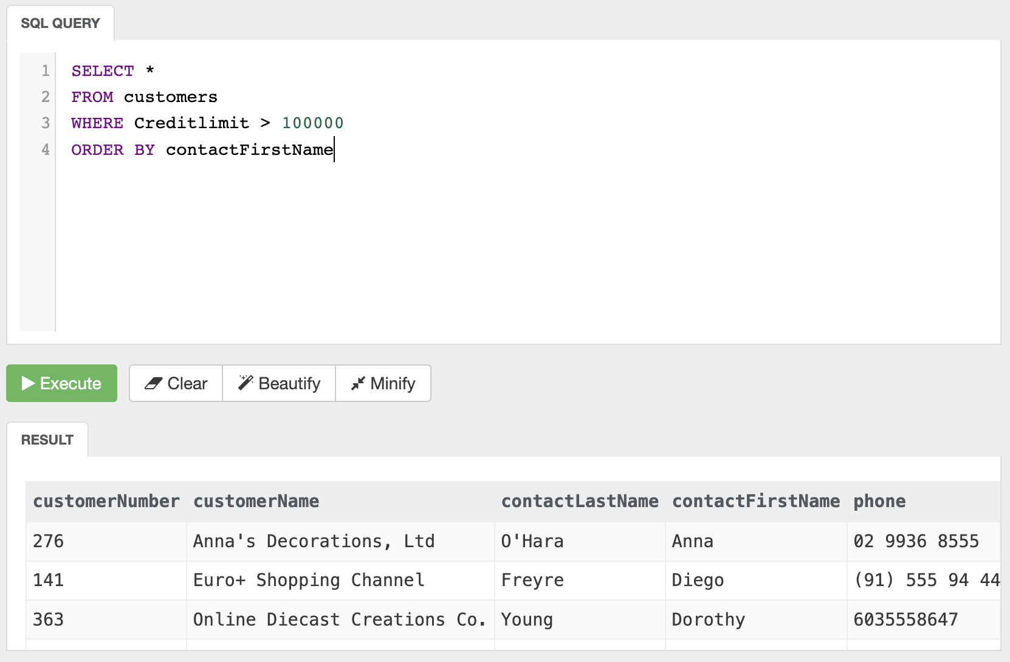
Ex-1

Slide 4
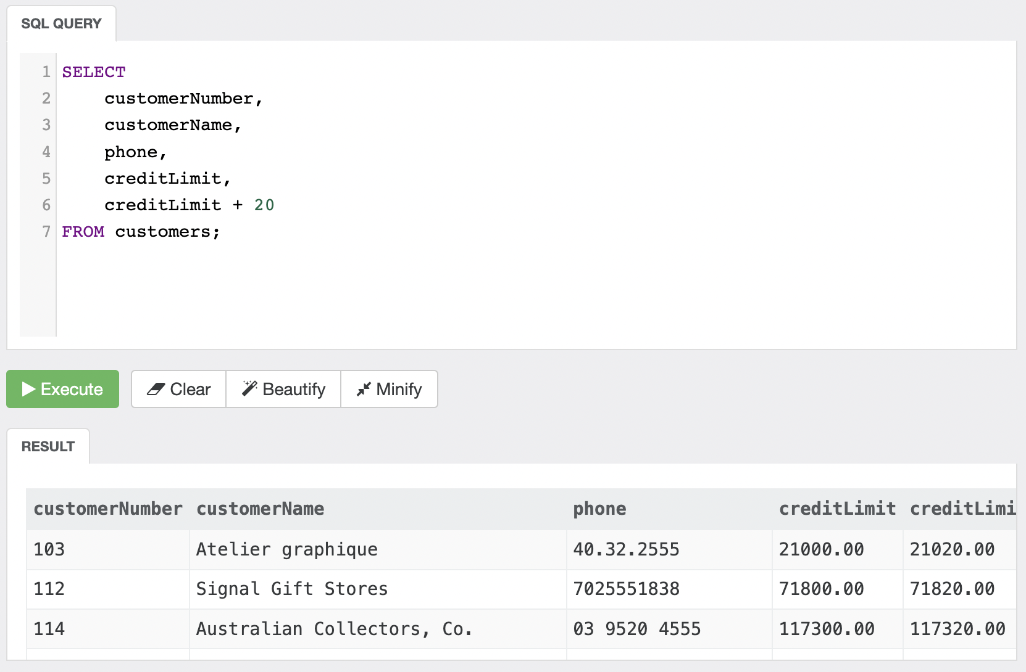
Ex-2

Slide 5
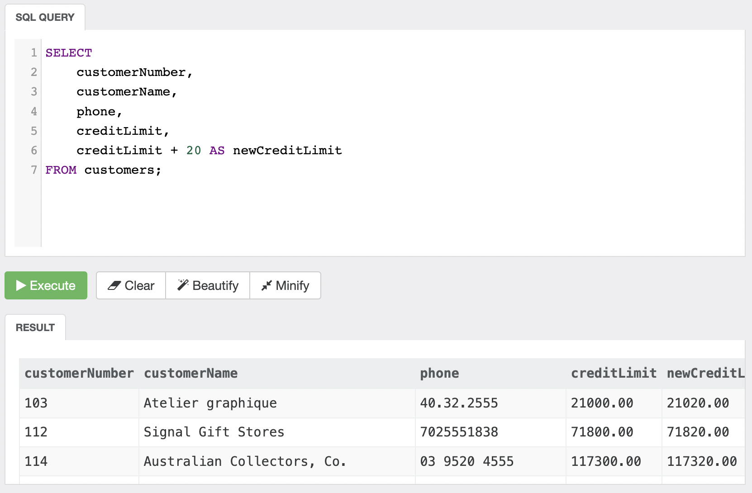
Ex-3

Slide 6
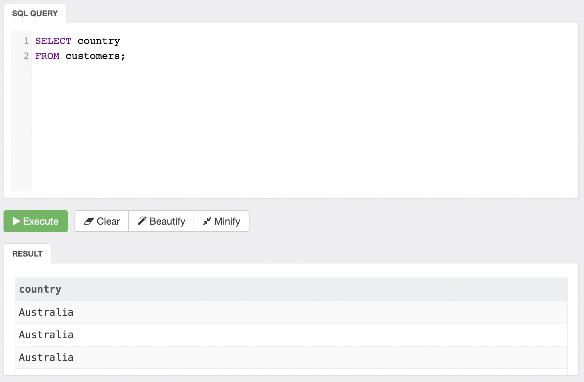
Ex-4 A

Slide 7
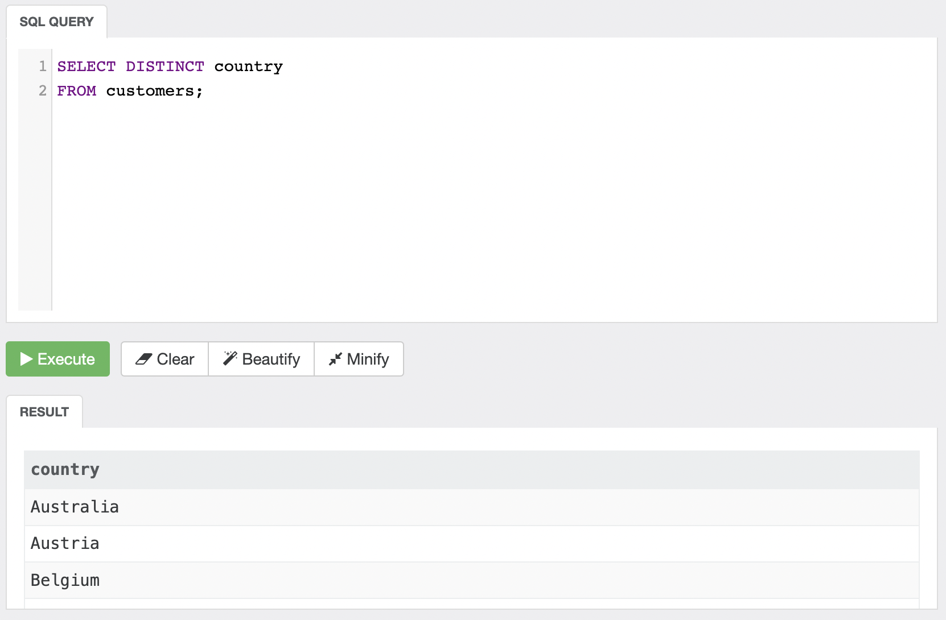
Ex-4 B

Slide 8
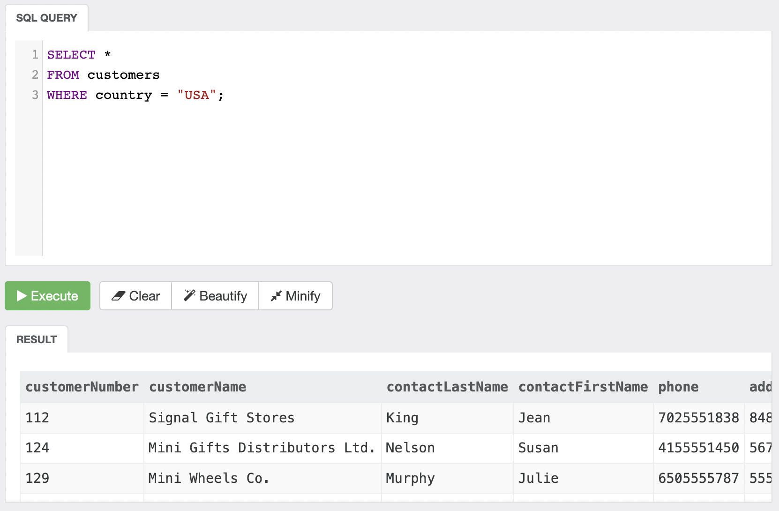
Ex-5

Slide 9
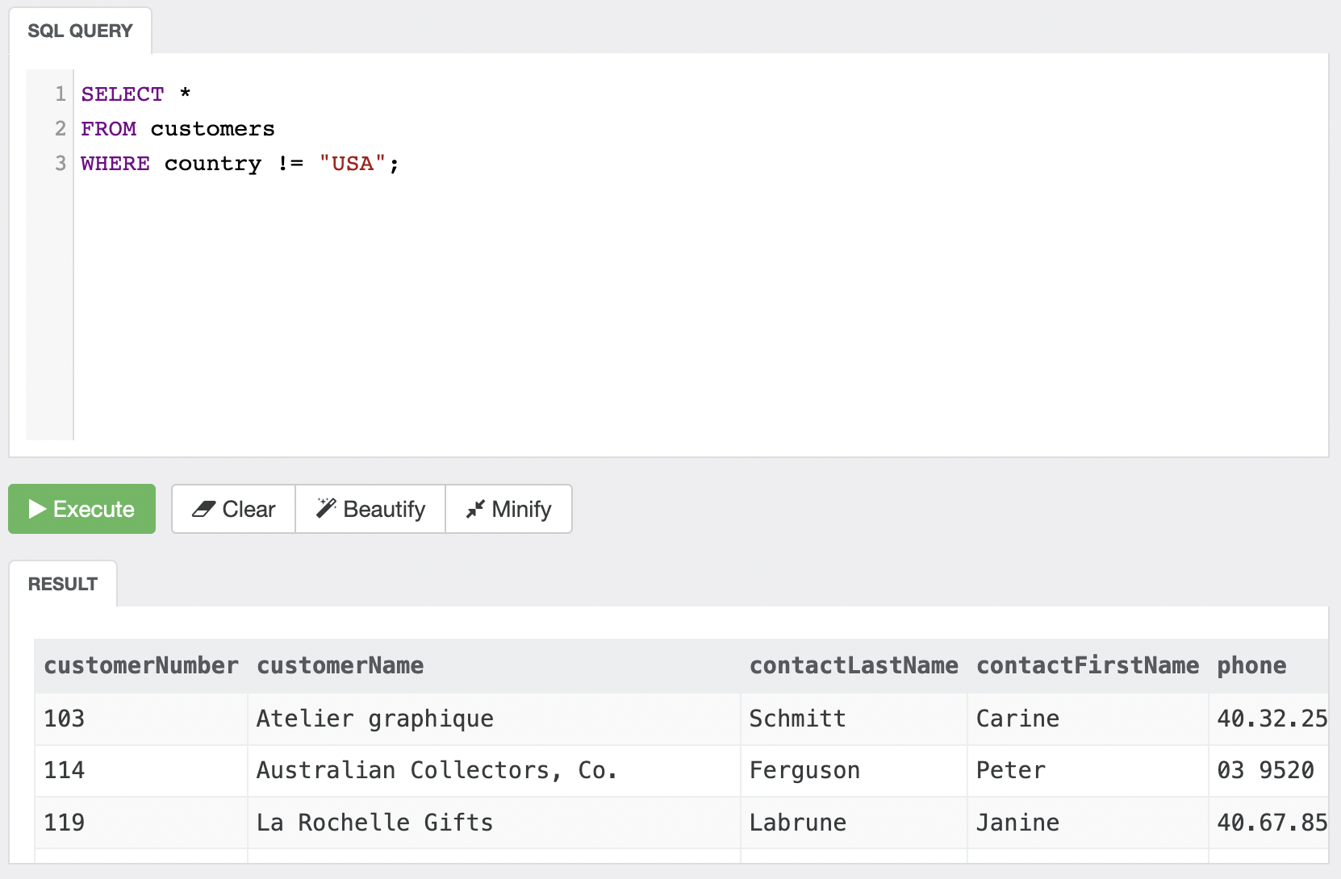
Ex-6 A

Slide 10

Ex-6 B

Slide 11
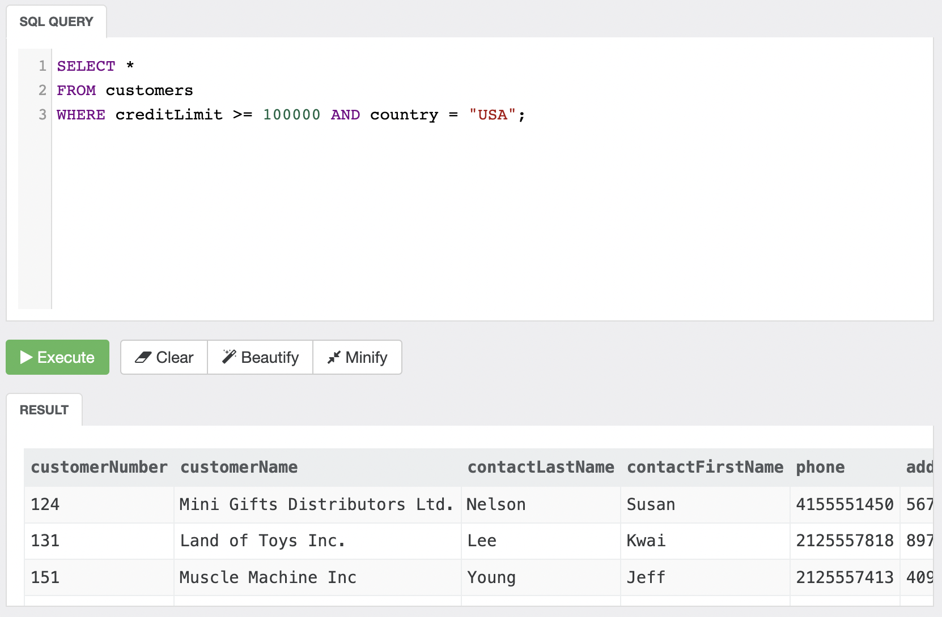
Ex-7 A

Slide 12
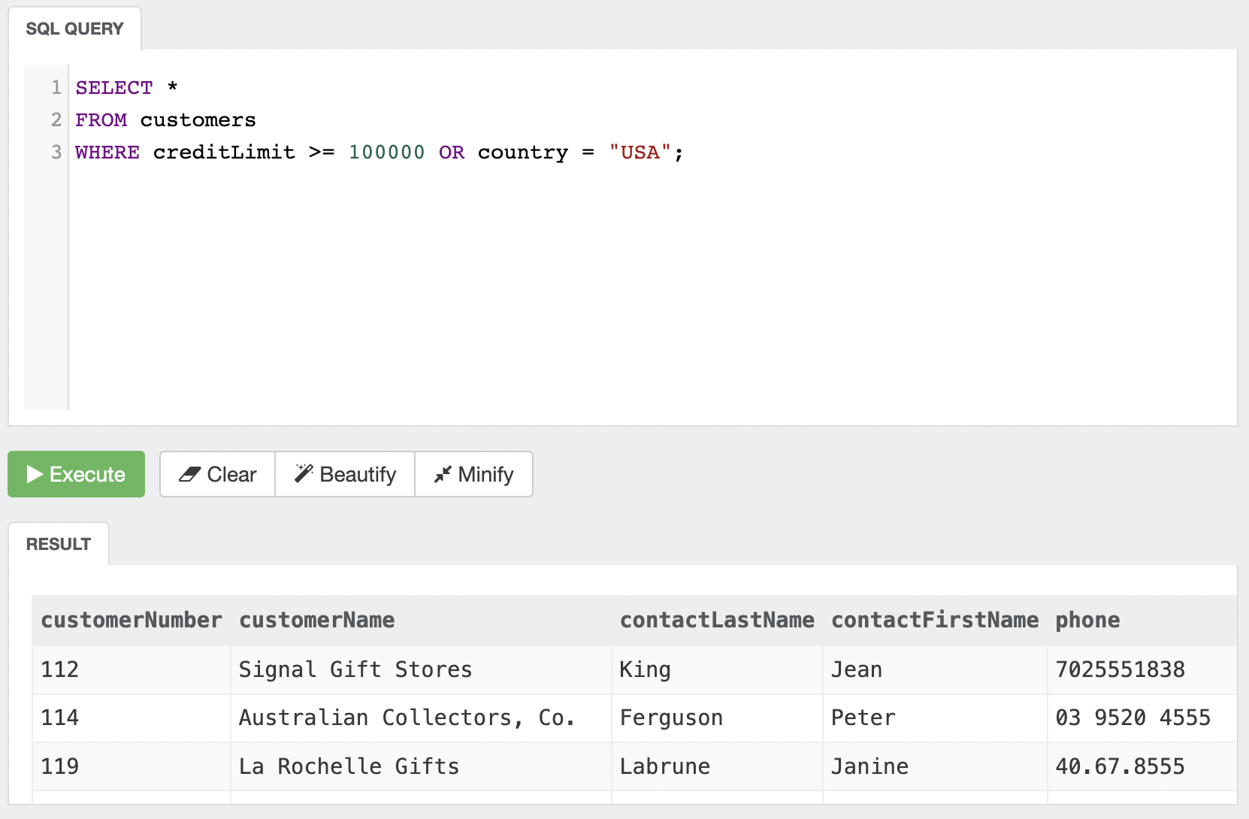
Ex-7 B

Slide 13
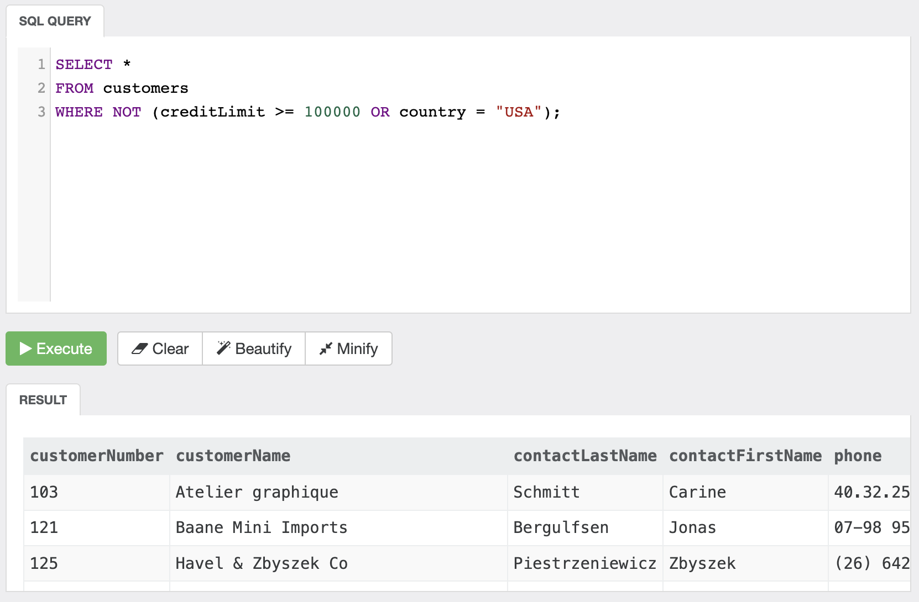
Ex-8

Slide 14
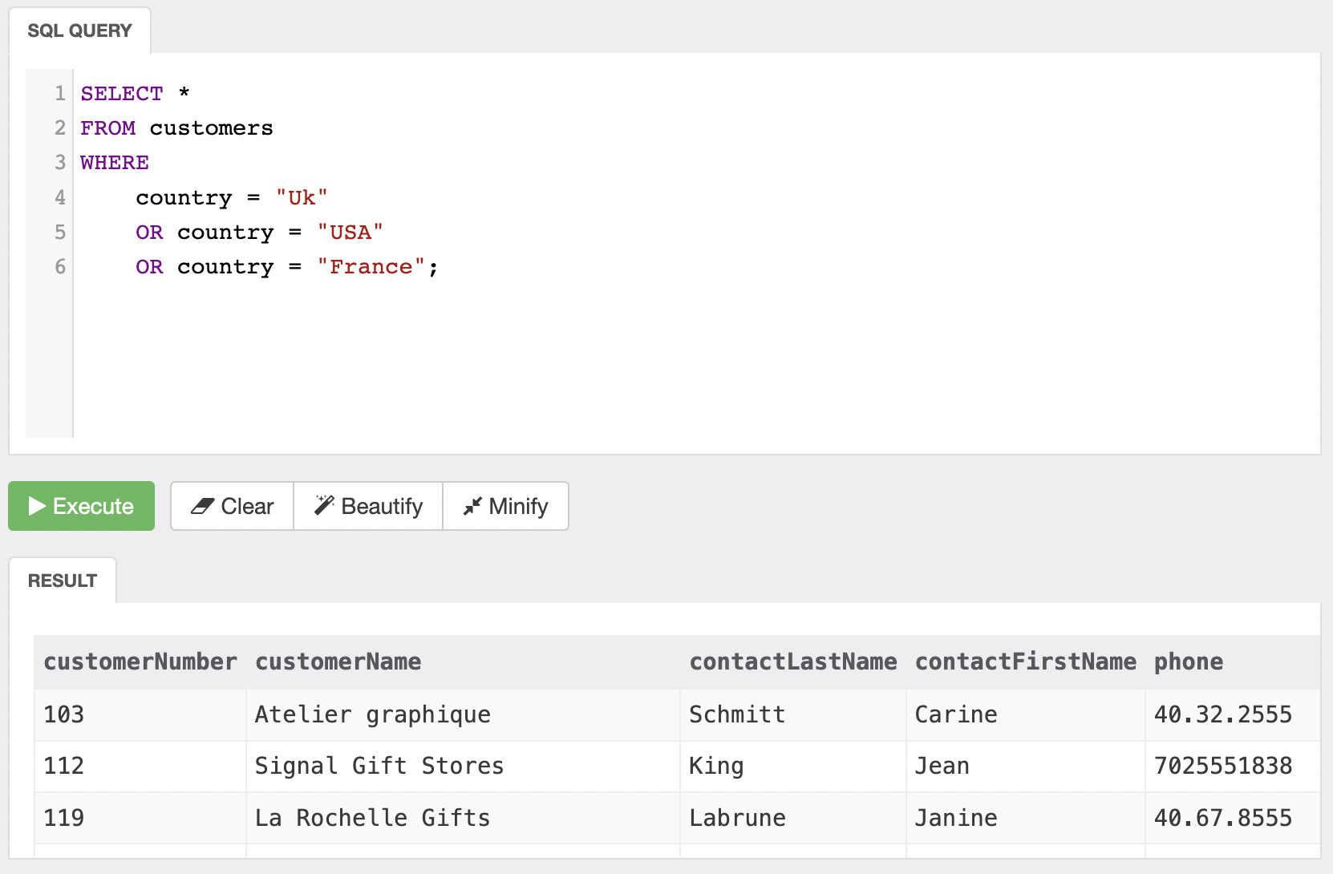
Ex-9 A

Slide 15
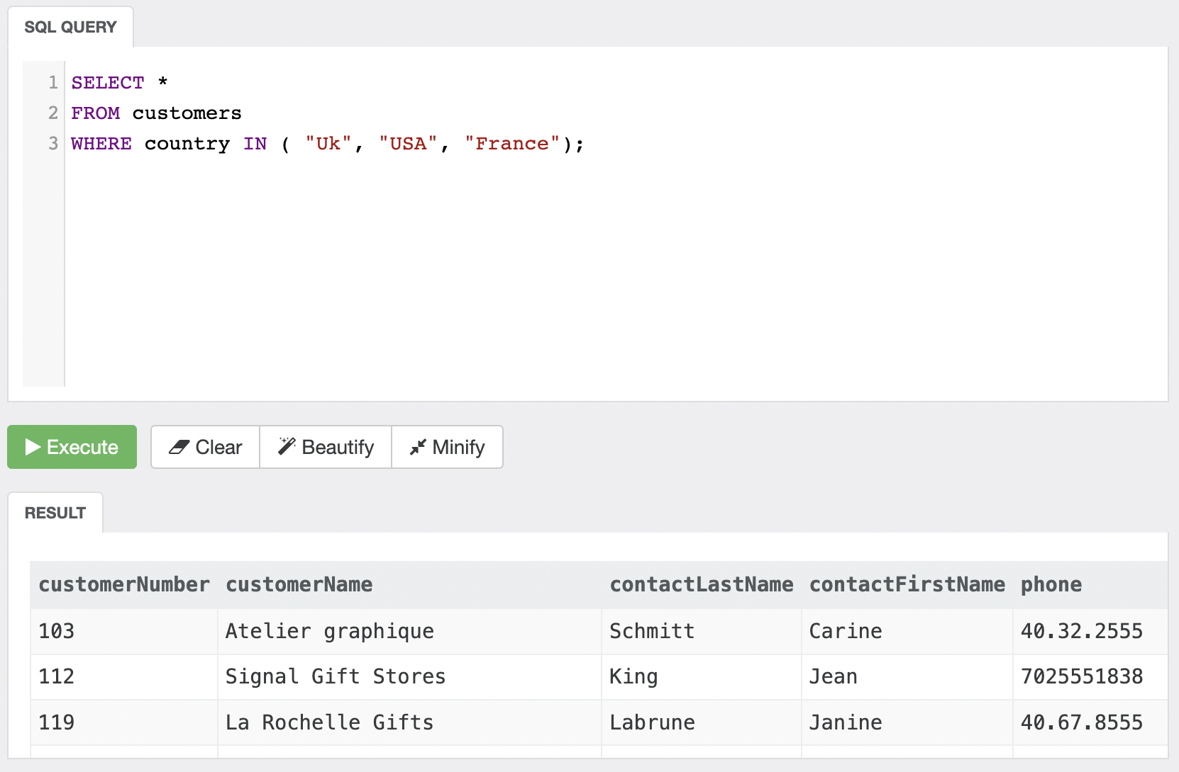
Ex-9 B

Slide 16
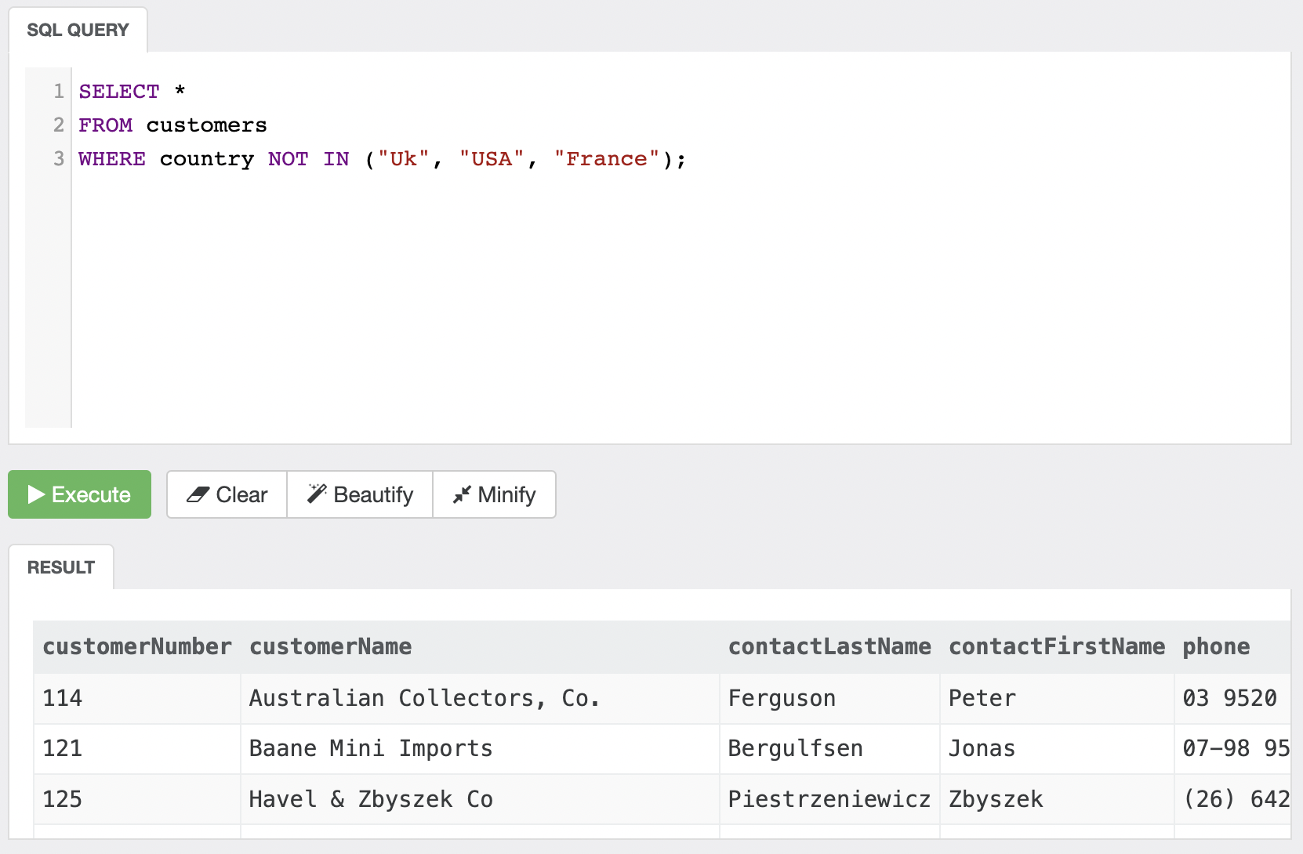
Ex-10

Slide 17
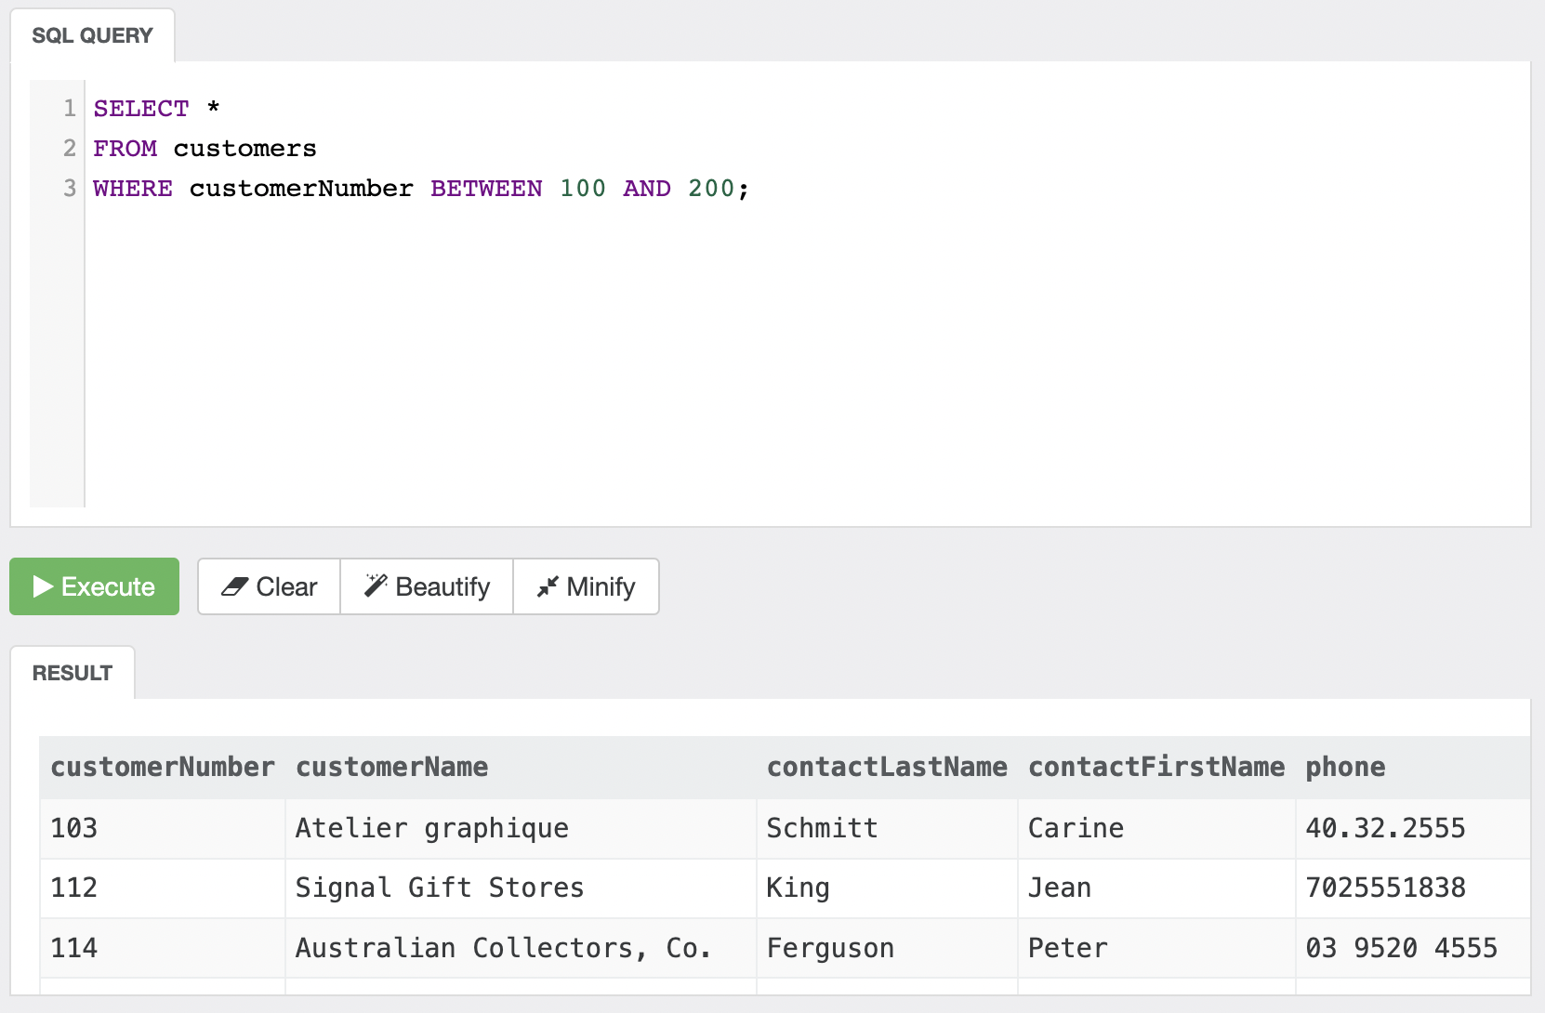
Ex-11

